Slide 1

What makes a successful Kickstarter?
Akshay Chougule, Abhijeet Deshmukh, Tejas Patil, Siddharth Ramshankar, Yang Shen

Slide 2
Agenda
Brief overview of Kickstarter
Description of Dataset
Research goals
Explanatory Data Analysis
Text analysis through word clouds
Modeling
Future research potential
Notes:
Added agenda page

Slide 3
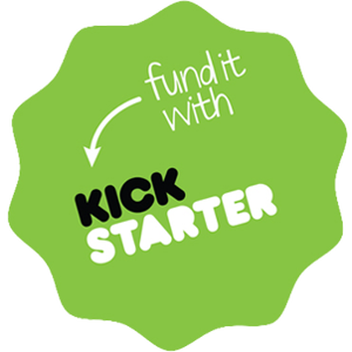
What is Kickstarter?
Kickstarter is a crowdfunding website used for non-traditional investment
If the goal is not met by the deadline, no funds are collected
Project must create something to share with others, no equity investment
On average, projects get 30 days to raise their minimum funding goal
Notes:
Odin
Reorder and reworded

Slide 4
Kickstarter Dataset
Original Source from Kaggle:
Created by Mickaël Mouillé, 7 versions, data from 2009-2018
15 Variables in the original dataset
ID: Unique Kickstarter ID | Launched: Date Kickstarter was started
Name: Name of project | Pledged: Amount pledged
Category: 159 unique classifications | State: Status of the project
Main_Category: 15 unique classifications | Backers: Number of pledgers
Currency: Original currency of kickstarter | Country: Country of origin for the project
Deadline: Ending date of kickstarter | usd pledge real: conversion in US dollars of the pledged column
Goal: Amount needed for success | usd goal real: conversion in US dollars of the goal column
Notes:
Odin

Slide 5
Goals for this Dataset
Initial goal is to examine what makes a successful kickstarter project
Data allowed us to group based on:
categories of projects
amount of money requested vs pledged
deadline for projects
Second goal is to identify whether success can be modeled for future entrepreneurs to target most important variables
Accomplished through
Dataset tidying
EDA
Text Analysis
Linear Modeling

Slide 6
Our Modifications to the original dataset
Filtered out anything with a deadline past 01/01/2018
Dataset is not updated to include status of projects with deadlines in 2018
Filtered cancelled projects
Filtered out “fishers”
Some people set up $1 goals, low and achievable, but not interesting if they succeed
Can explore this data further later
Created Variables
Overage <– USD_Pledged_Real – USD_Goal_Real, how much more did successful projects get than they expected
PctFunding<-100*USD_Pledged_Real/USD_Goal_Real, how close did campaigns get to their goal?

Slide 7
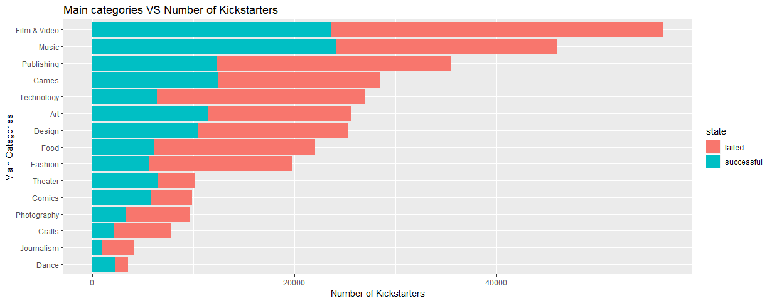
CATEGORIES OF PROJECTS IN KICKSTARTER
Trends:
Maximum Number of Kickstarter Projects - Film & Video and Music Category
Minimum Number of Kickstarter projects -
Dance and Journalism Category
Inferences:
Maximum Success - Technology and Entertainment Category
Minimum Success – Art and Literature Category
Notes:
Akshay

Slide 8
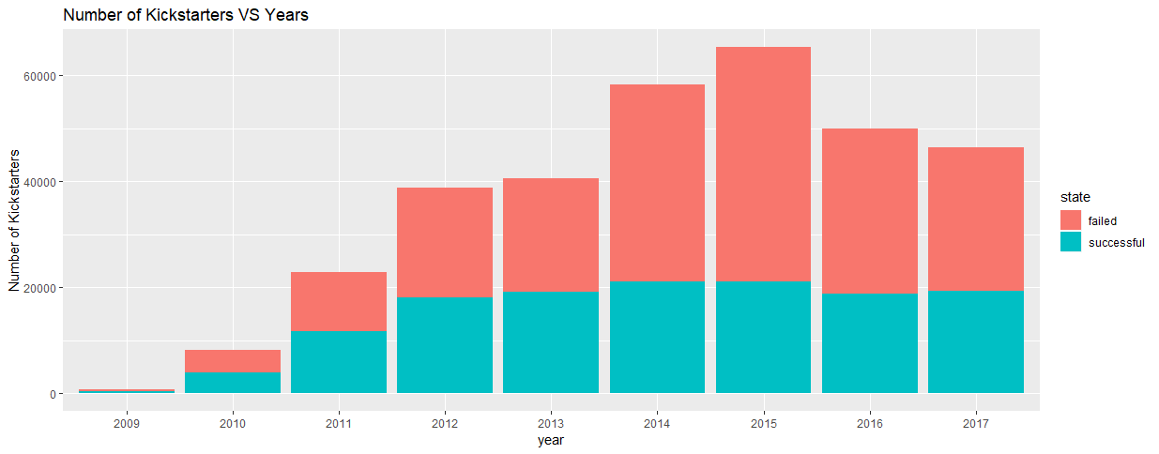
KICKSTARTER EXPANSION OVER THE YEARS
Notes:
Tejas

Slide 9
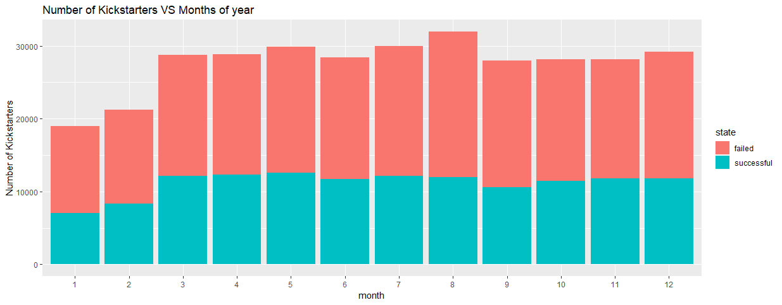
WHAT MONTHS IS KICKSTARTER MORE ACTIVE?
Notes:
Tejas

Slide 10
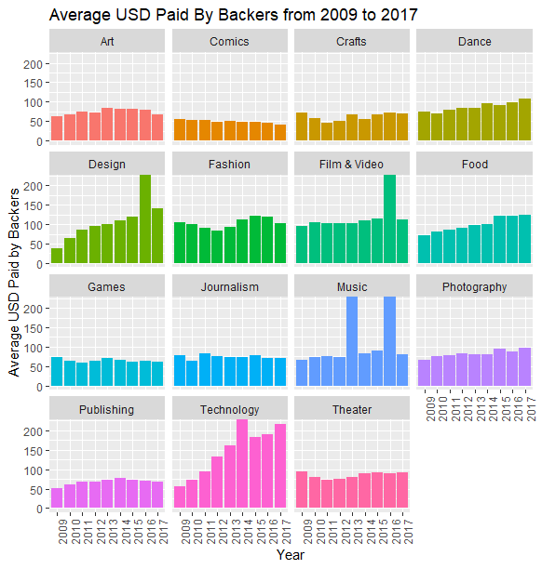
INSIGHTS ABOUT BACKERS & DONATIONS
Main Category | Average Number of Backers | Average USD given by Backers | Average Amount Pledged per Project
Art | 46 | $77.00 | $3,542.00
Comics | 146 | $50.00 | $7,300.00
Crafts | 30 | $60.00 | $1,800.00
Dance | 45 | $81.00 | $3,645.00
Design | 275 | $102.00 | $28,050.00
Fashion | 69 | $93.00 | $6,417.00
Film & Video | 73 | $93.00 | $6,789.00
Food | 59 | $95.00 | $5,605.00
Games | 383 | $66.00 | $25,278.00
Journalism | 44 | $69.00 | $3,036.00
Music | 59 | $72.00 | $4,248.00
Photography | 44 | $91.00 | $4,004.00
Publishing | 62 | $60.00 | $3,720.00
Technology | 187 | $129.00 | $24,123.00
Theater | 50 | $85.00 | $4,250.00
Notes:
Tejas
We couldn’t come up with a better title. Feel free to edit it if you have a better title

Slide 11
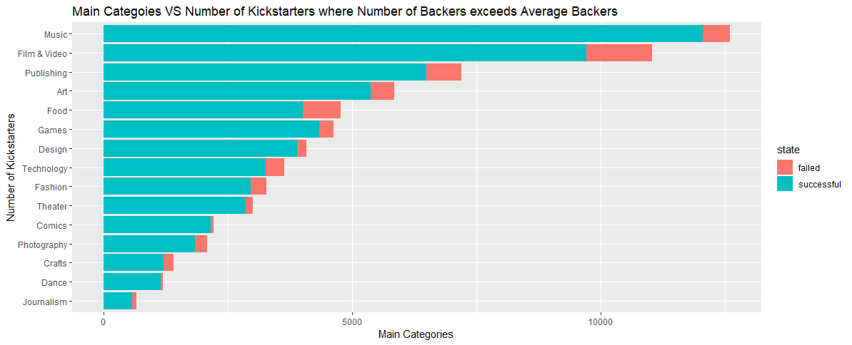
How likely is a project to succeed when you have more backers than average?
Notes:
Abhijeet

Slide 12
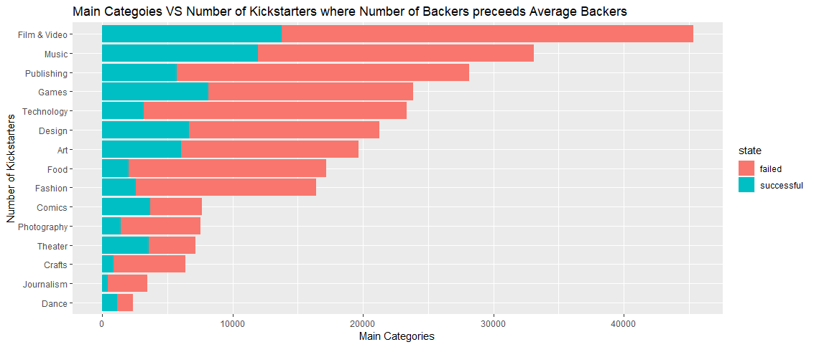
How likely is a project to succeed when you have fewer backers than average?
Notes:
Abhijeet

Slide 13
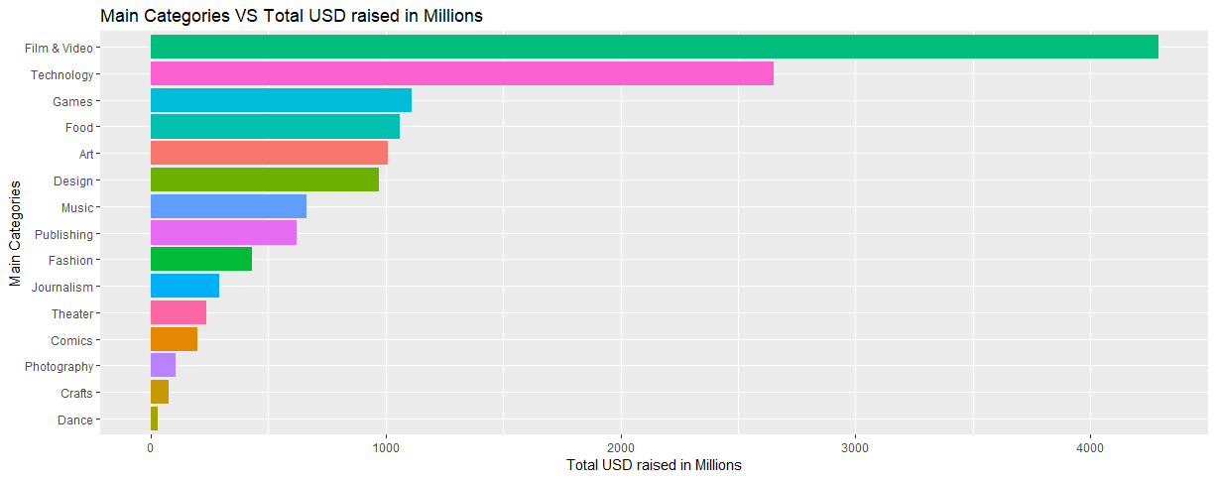
How much money has each category raised from 2009-2017?
Inferences:
Maximum Revenue Generation - Technology and Entertainment Category
Minimum Revenue Generation - Art and Literature Category
Notes:
Abhijeet

Slide 14
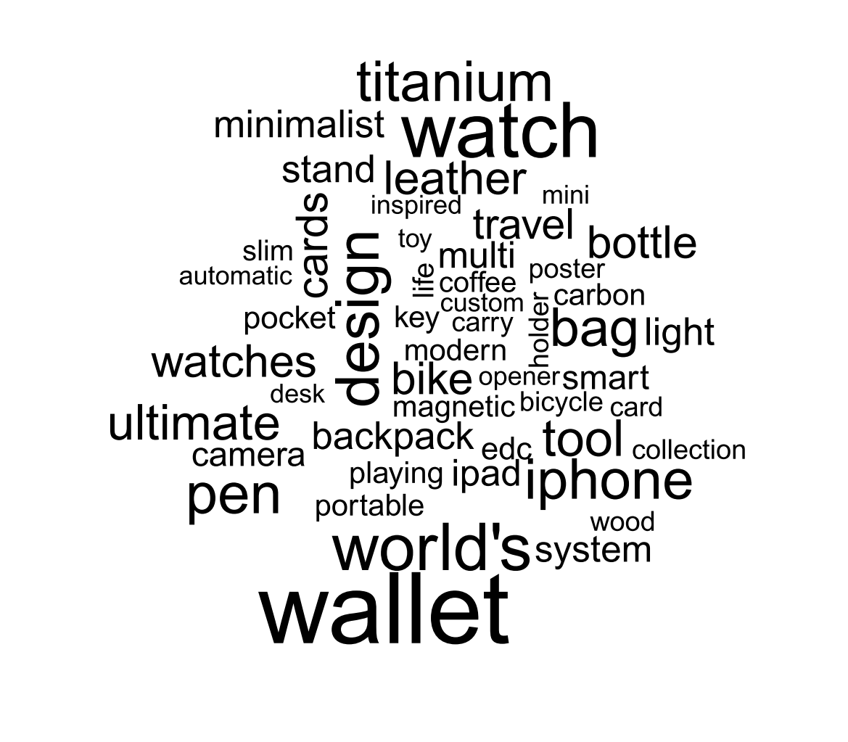
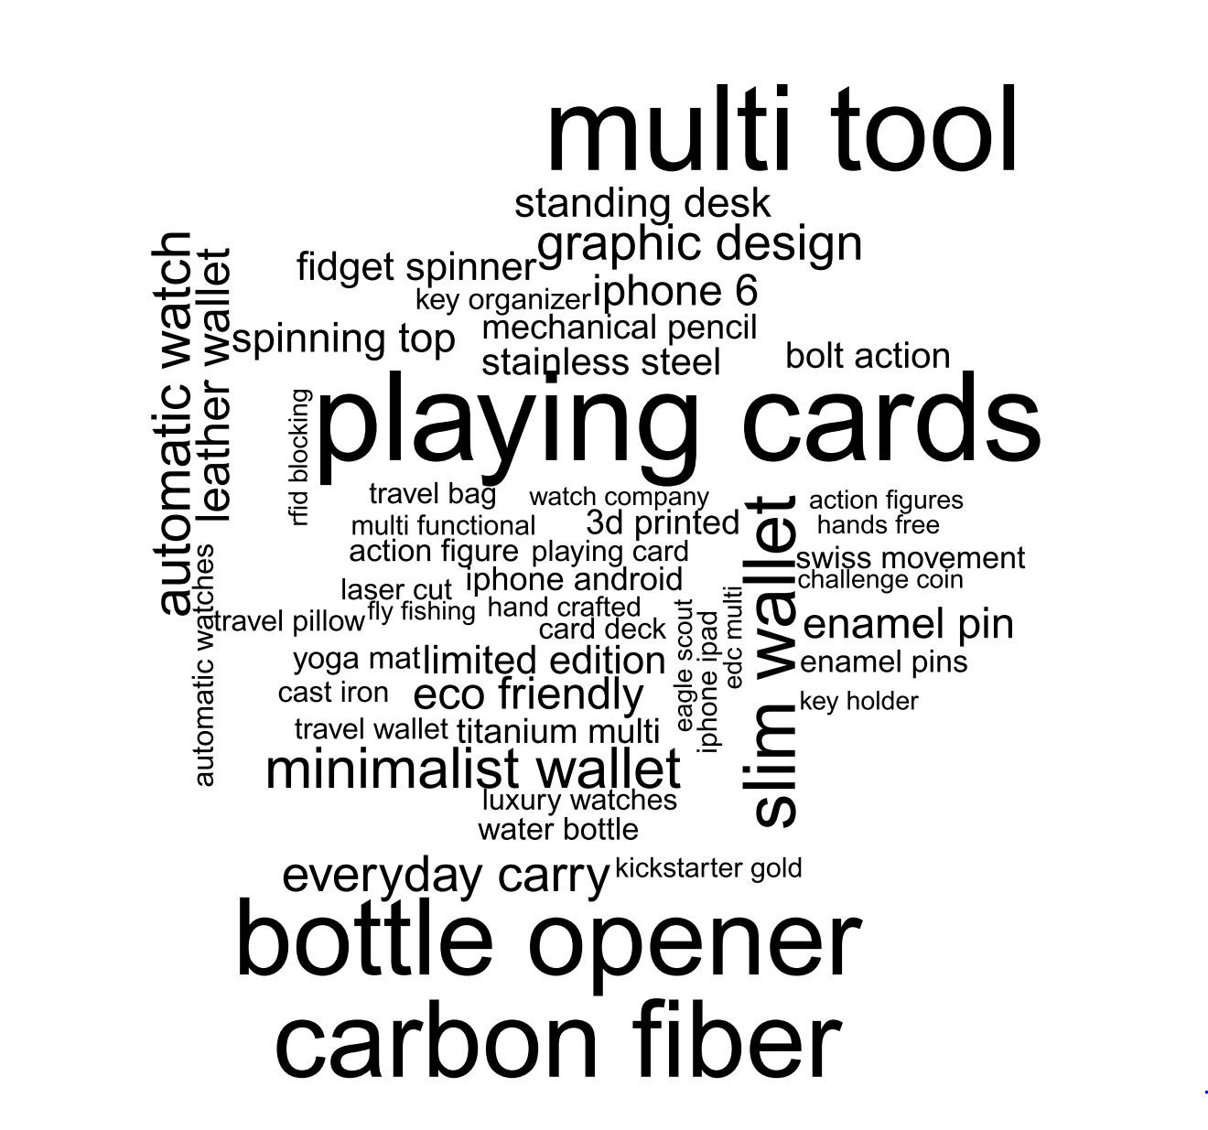
What’s in a project name? Design
Notes:
Odin

Slide 15
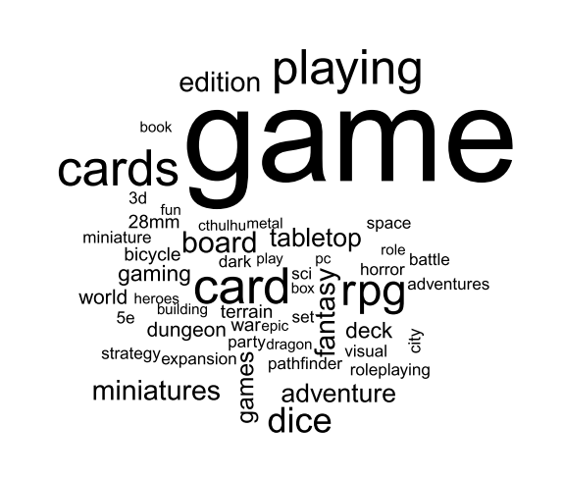
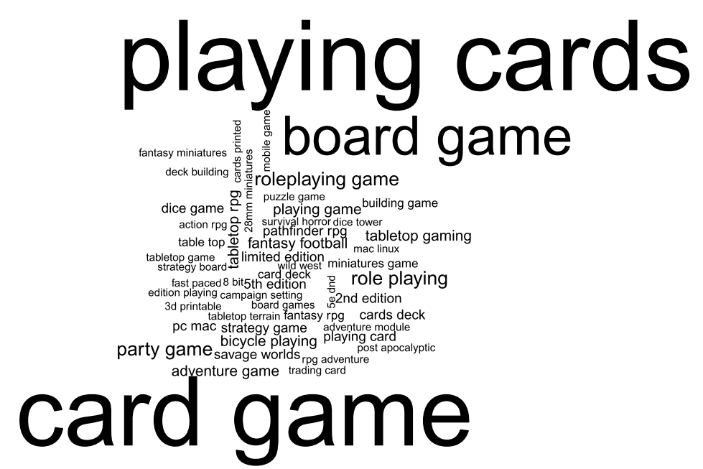
What’s in a project name? Games
Notes:
Odin

Slide 16
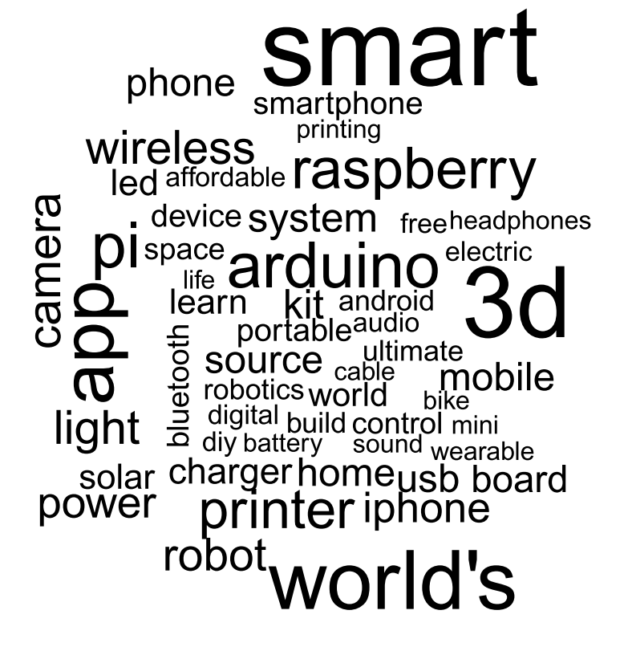
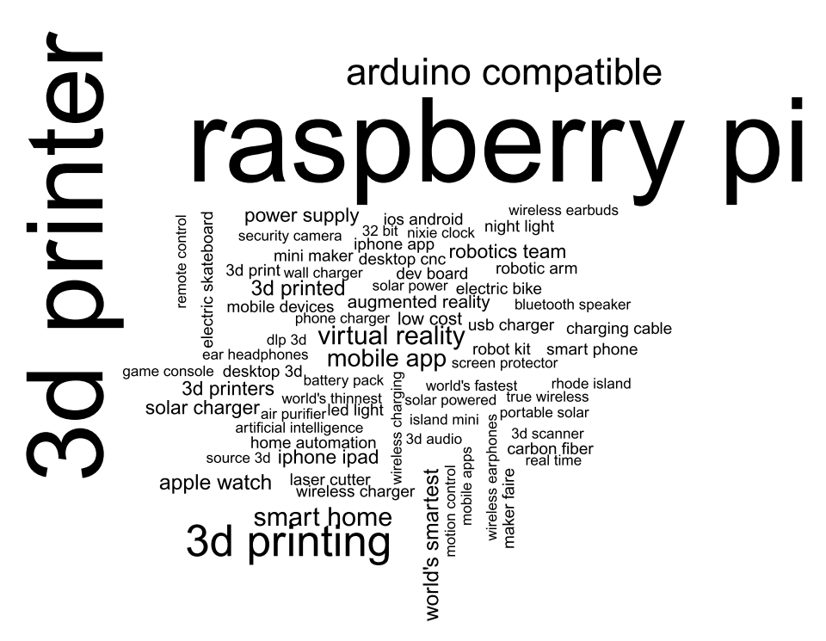
What’s in a project name? Technology
Notes:
Odin

Slide 17
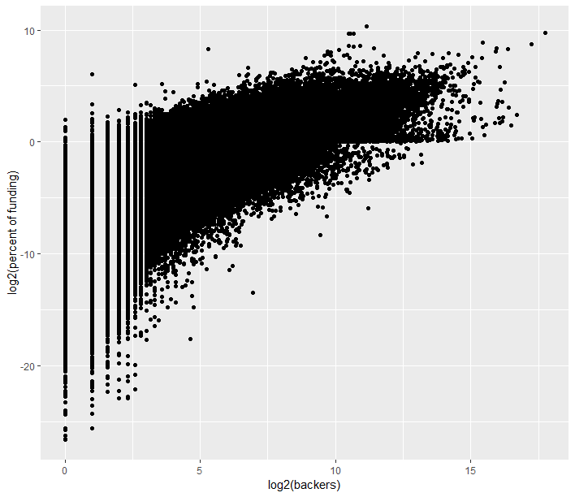
Generating a Model
First variable selected – Backers
Important variable in identifying how many pledges you will get
Initial model generated showed linearity after log-log transformation
$$\log_{2}\left(Percent Funding\right) \sim \log_{2}{(backers)}$$
Notes:
Siddharth – check alpha value on graph

Slide 18
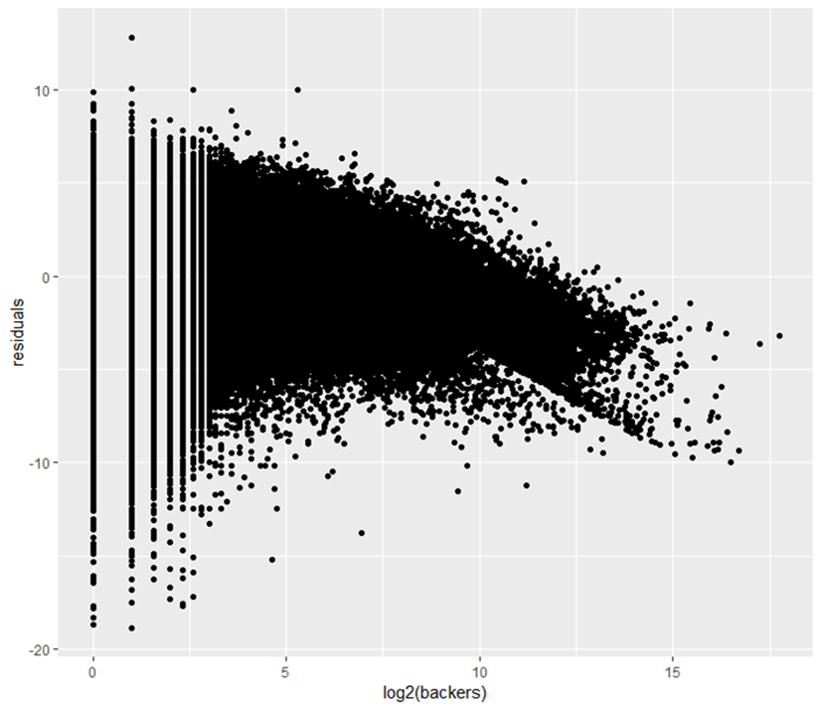
Is it normal?
Testing the residuals of the model against backers
Distribution is normal, centered around 0
Artifacts due to log transformation
RMSE = 2.480282
Need to look towards other variables to see if improvements are possible
Notes:
Siddharth

Slide 19
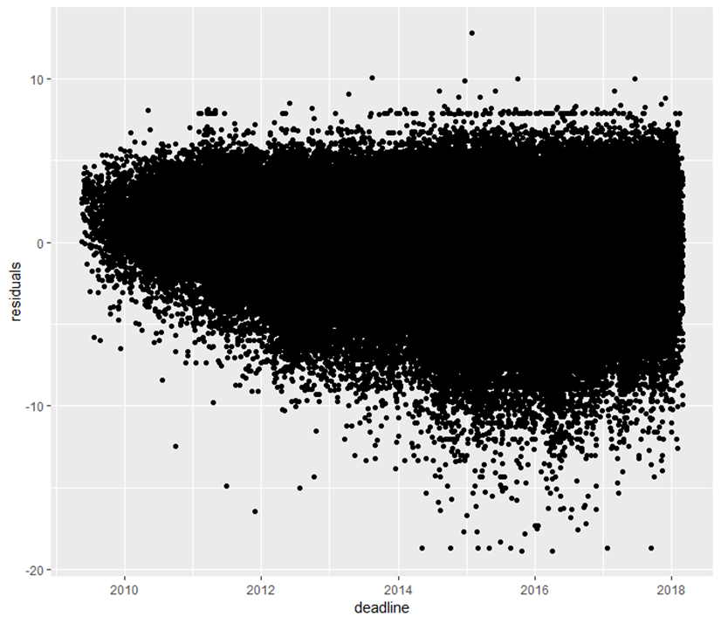
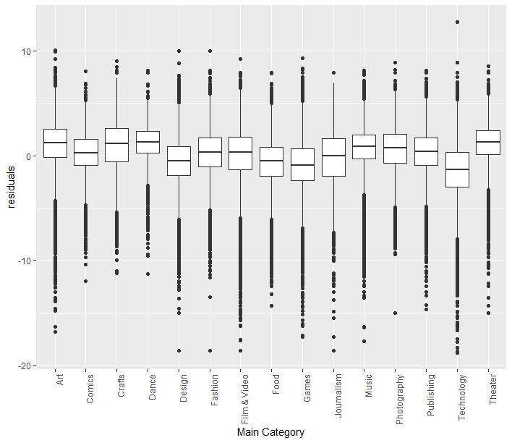
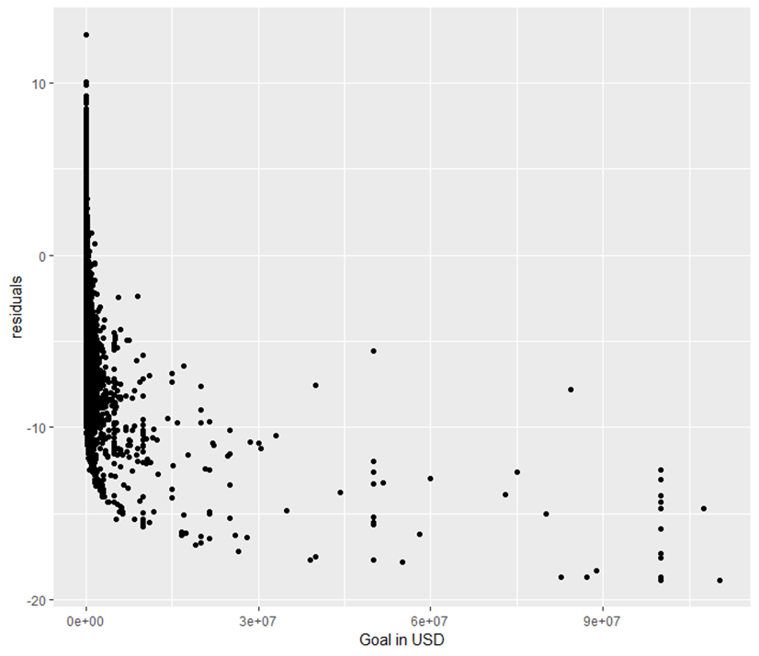
Making Improvements
Deadline
Main Category
Goal in USD
Plotted against residuals, Deadline, Main Category, and Goal in USD stand out
Deadline – Imbalance toward the negative for projects started more recently
Main Category – slight change in medians
Goal in USD – non-linear relationship with residuals necessitates another transformation
Notes:
Siddharth

Slide 20
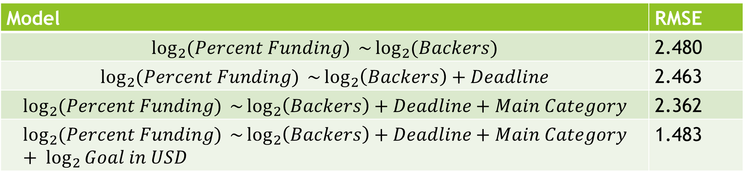
Crossvalidated Linear Models
Performed k-fold Cross Validation to train and test models, k = 5
Model | RMSE
$$\log_{2}{(Percent Funding)} \sim \log_{2}{(Backers)}$$ | 2.480
$$\log_{2}{(Percent Funding)} \sim \log_{2}\left(Backers\right)+Deadline$$ | 2.463
$$\log_{2}{(Percent Funding)} \sim \log_{2}\left(Backers\right)+Deadline+Main Category$$ | 2.362
$$\log_{2}{(Percent Funding)} \sim \log_{2}\left(Backers\right)+Deadline+Main Category+ \log_{2}{Goal in USD}$$ | 1.483
Notes:
Siddharth

Slide 21
Can we predict success?
What variables are important for success?
Backers and the Fundraising goal have the most impact
Generate generalized linear model to measure success or failure
Formula = Success or Failure ~ Number of Backers + Fundraising Goal (USD)
Link function = logit
Failure = 0
Success = 1
At cutoff of .75, model is 82.3% accurate
Sensitivity = 59.4%, Specificity = 97.9%
At cutoff of .90, model is 77.1% accurate
Sensitivity = 45.5%, Specificity = 98.7%
Our model is quite conservative!

Slide 22
Conclusions
EDA conclusions
Kickstarter might be facing a downturn
Number of people approaching the platform, since 2015
The main categories naturally attract different classes of backers
Who you might be able to reach with your product? Will they pay a lot or a little?
Model Conclusions
Backers are important!
Understanding the target market, reaching them, and getting them hyped to donate is major key to success
Setting reasonable goals is important!
Unreasonable goals will result in failure, and NO funding!

Slide 23



Future avenues for research?
Is Kickstarter truly race-blind?
Collect dataset on racial identification of project owners and identify trends of funding
Use glm() to see if research proves race-blindness of the platform
Is there a shopping behavior on Kickstarter?
People donating money after project reach it’s goal are basically “shopping” for products.
Compare other crowdfunding platforms
GoFundMe, IndieGoGo, and Patreon have also emerged on the market
Are patterns similar? Is a particular platform gaining market share over others? Is this split based on Main Category?
Notes:
Added one point

